Slide 1
What Sugars are in your Food?

Slide 2
Look Out For Hidden Sugars!
Hidden sugar can be harming your health.
IN ONE DAY A CHILDS MAXIMUM DAILY ALLOWANCE is:
4-6 years =
5 sugar cubes
7-10 years =
6 sugar cubes
11 + years =
7 sugar cubes

Slide 3
Too Much Sugar Can Cause…
Tooth Decay
Sugar is bad for teeth and can result in cavities, toothache and teeth being taken out in some cases.
Child Obesity
The extra calories that sugar adds to children’s diet can lead to weight gain and obesity.
Type 2 Diabetes, Heart Disease and some Cancers.
To much sugar can lead to the build up of harmful fat in the body which can cause serious disease in the future.

Slide 4
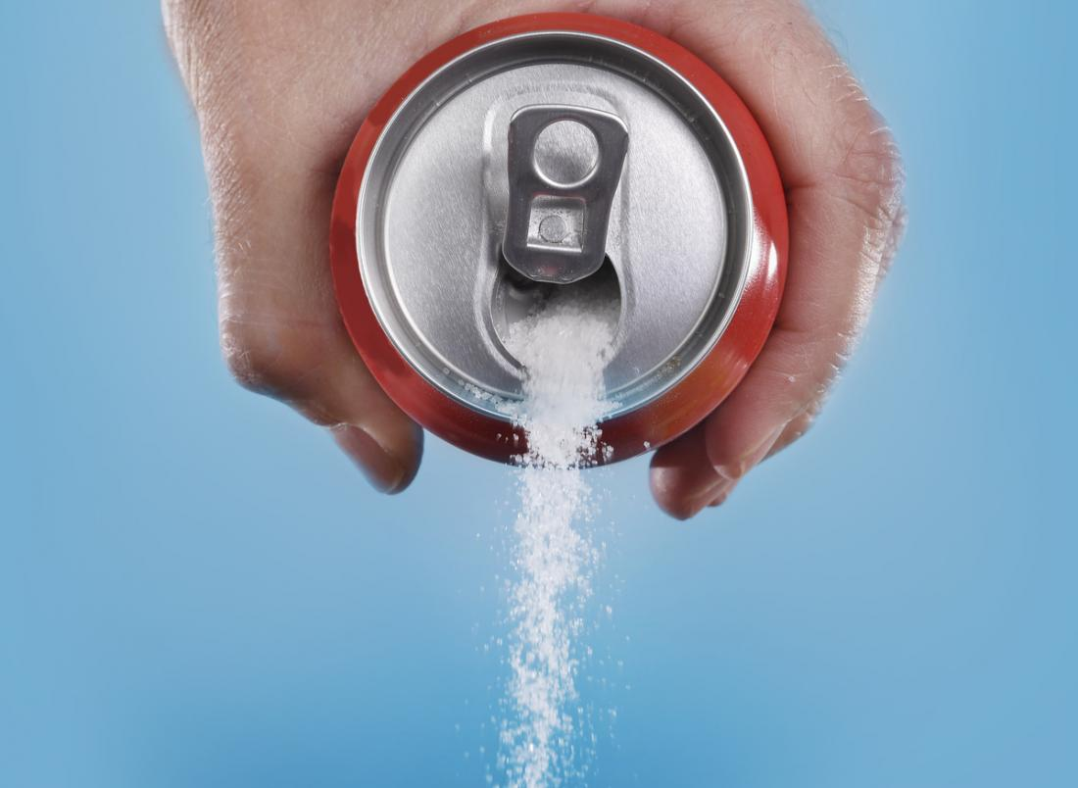
How Much Sugar Do You Drink?

Slide 5
Sugary Drinks Are One of The Biggest Sources of Sugar in Children’s Diet.
The sugar found in sugary drinks, including fruit juices can cause tooth decay.
The acid found in all soft drinks, including diet and ‘no added sugar’ can cause damage to tooth enamel.
If you choose a sugary or diet drinks, have these with meals.

Slide 6
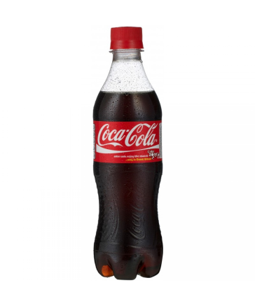
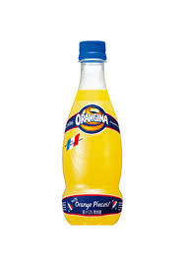
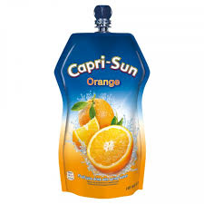
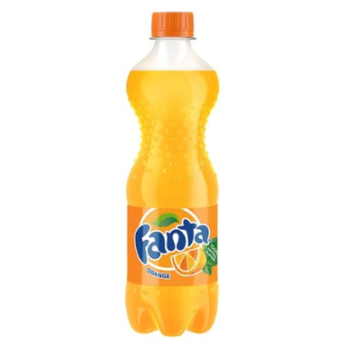
Can you Guess The Amount of Sugar Cubes in Each Drink?
500ml
Coca Cola
500ml
Fanta
420 ml Orangina
330ml pouch Capri sun
14
5.7
10.5
8.2

Slide 7
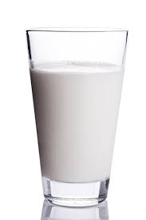
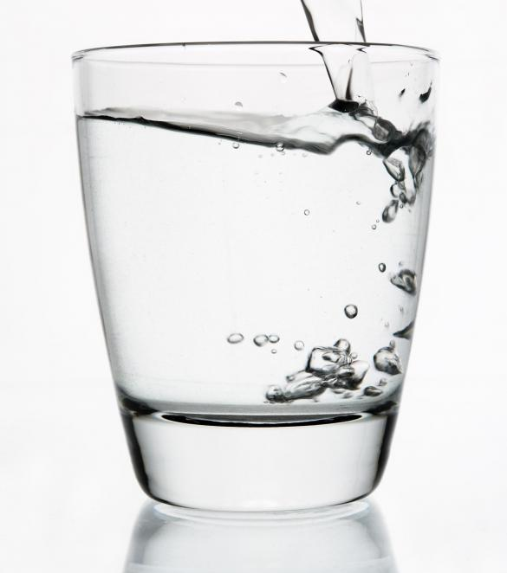
Healthier Options
Tap Water
Semi Skimmed Milk

Slide 8
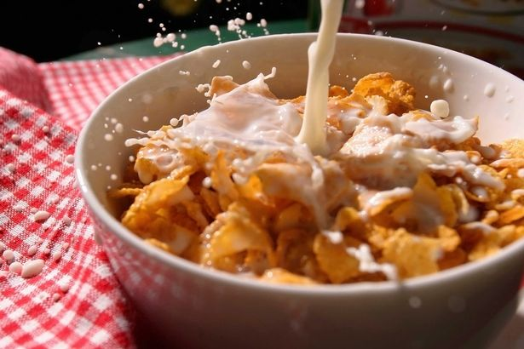
Breakfast Cereals
Some breakfast cereals contain up to 3.7 sugar cubes, so you could be having over half of your daily allowance before school!

Slide 9
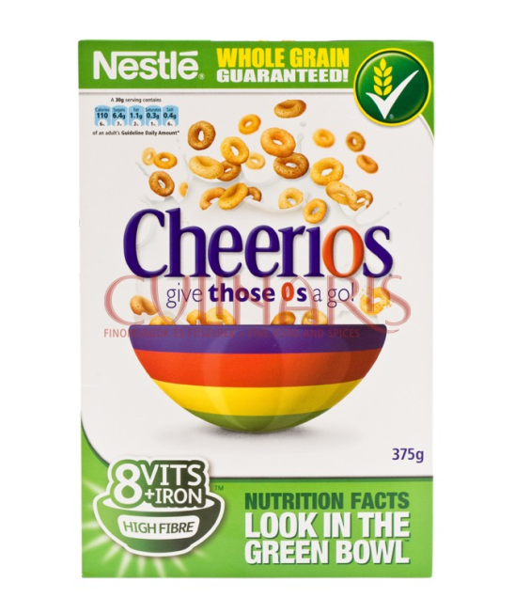
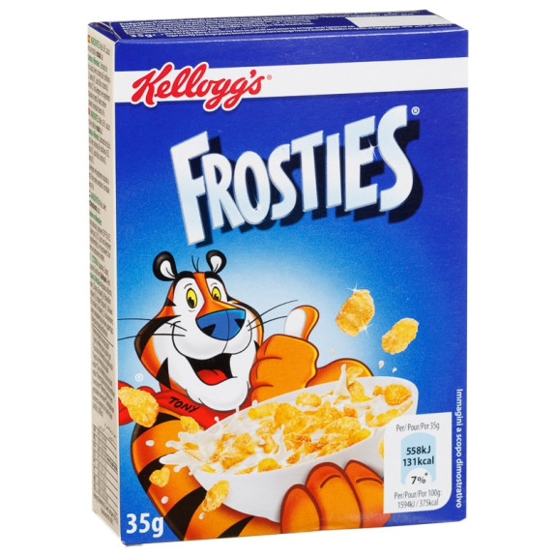


How Much Sugar Is In Your Cereal?
How much sugar is in a 40g bowl of cereal?
3.7
3
2.1
1.8

Slide 10
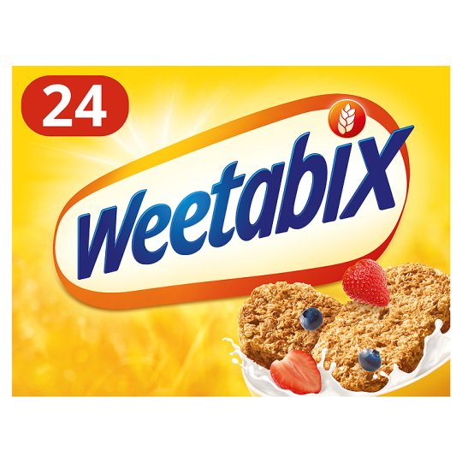
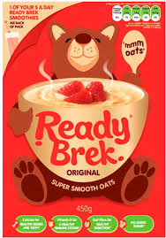
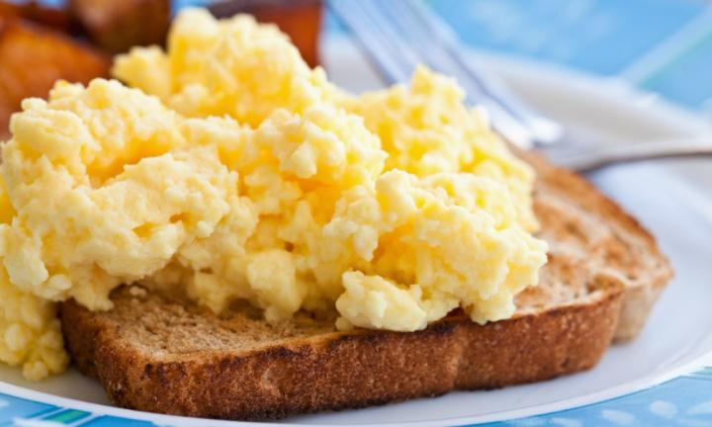
Healthier Options
These are low Sugar healthier options that are less than
0.5 sugar cubes.

Slide 11
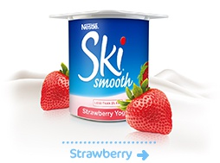
Are Yoghurts Pushing Children Over Their Daily Sugar Limit ?
Some yoghurts can contain over 4 sugar cubes in one pot.
If you also have a sugary drink as well this can add up to a shocking amount of sugar!

Slide 12
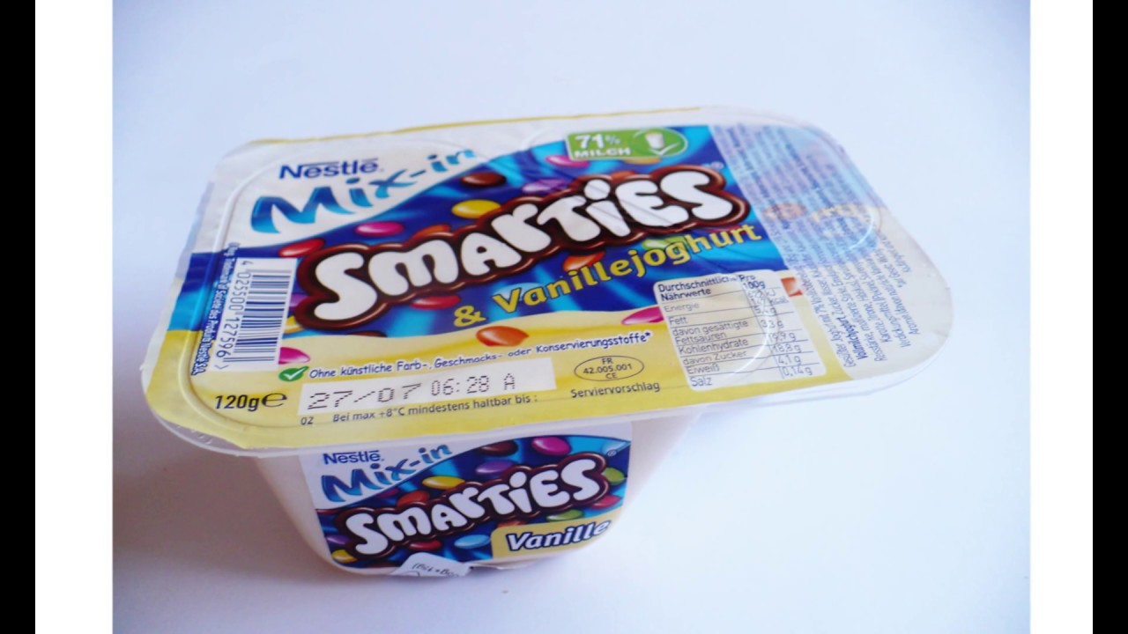

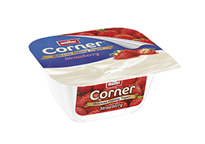
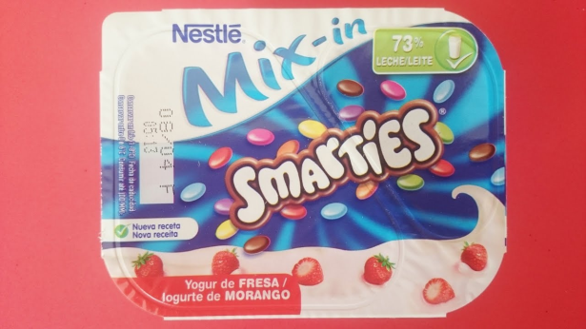
How Many Sugar Cubes?
2.2
4.9
3.3

Slide 13
So watch out for hidden sugars that can add up to health problems.
To see how much sugar is in more yoghurts, breakfast cereals and drinks use the online sugar check at:
savekidsfromsugar.co.uk

