Slide 1
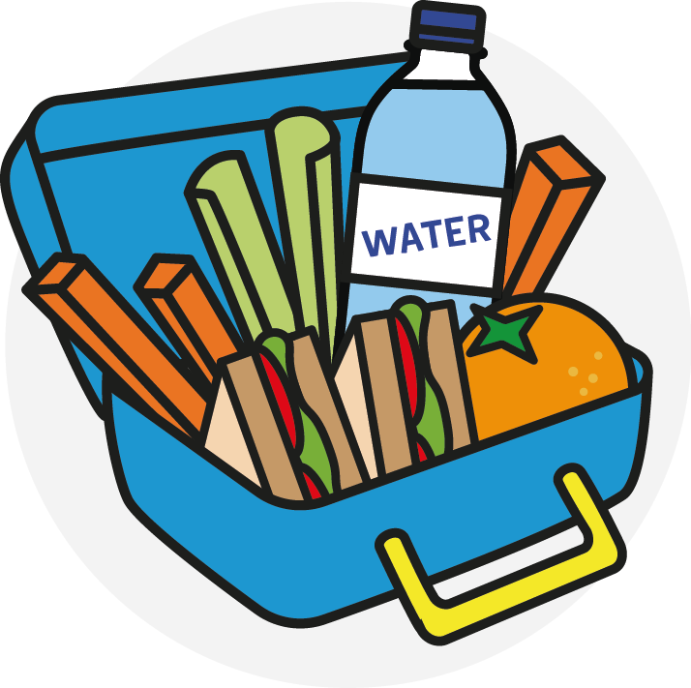
CREATE
YOUR
OWN
HEALTHY
LUNCHBOX!
Click here to start!

Slide 2
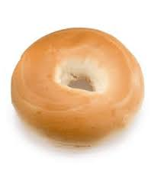
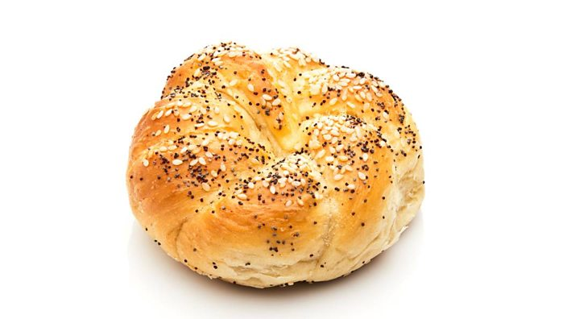
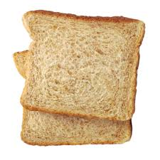

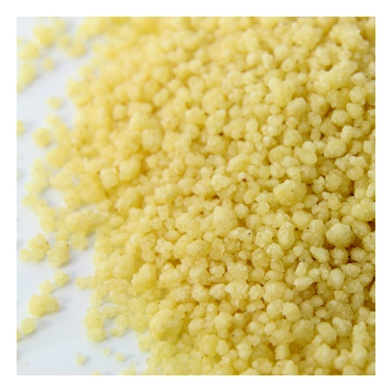
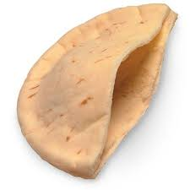
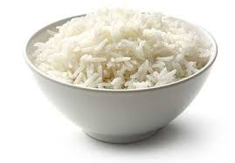
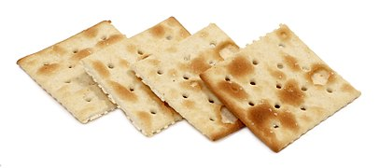

Choose one carbohydrate
Pasta
Bread roll
Bagel
Bread
Rice
Pitta bread
Couscous
Wrap
Click here to choose your filling.
Crackers

Slide 3

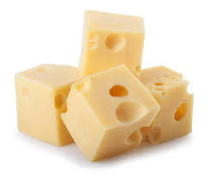
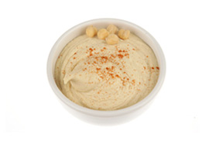
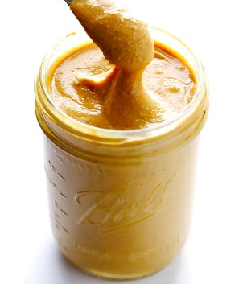

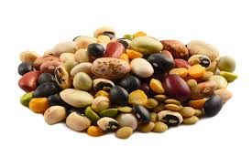
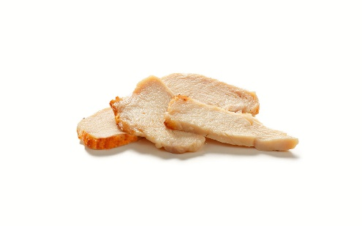
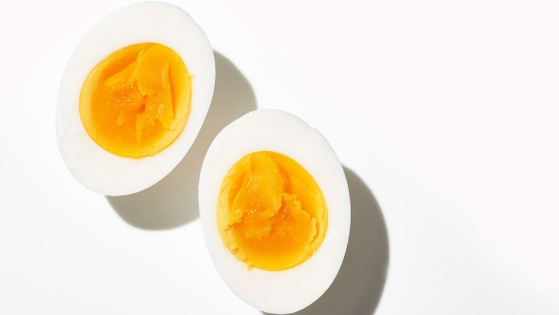

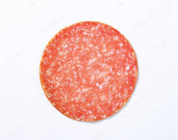
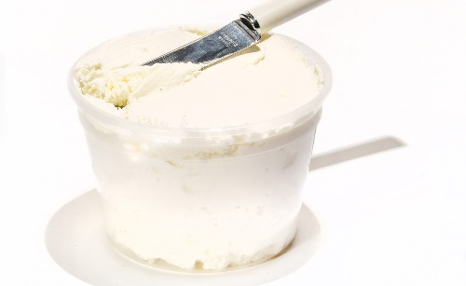
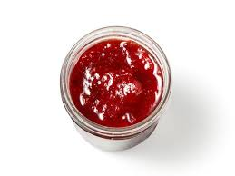
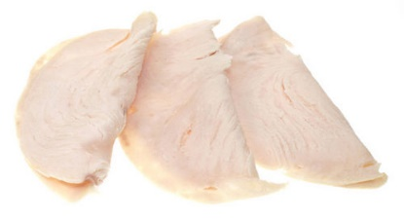
Choose one main filling
Quorn slices
Cheese
Peanut butter
Houmous
Ham
Beans
Chicken
Egg
Salami
Banana
Click here to
add salad.
Turkey
Cream cheese
100% fruit jam
Click here to
choose your
potion of
fruit/veg.

Slide 4
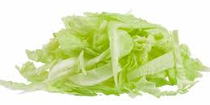
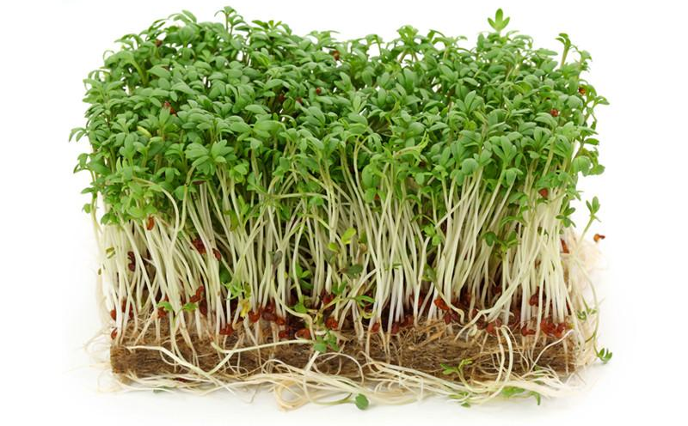

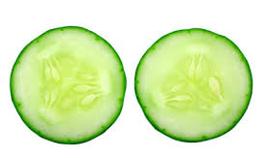
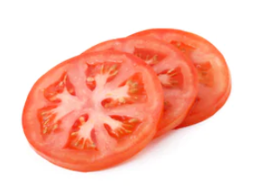
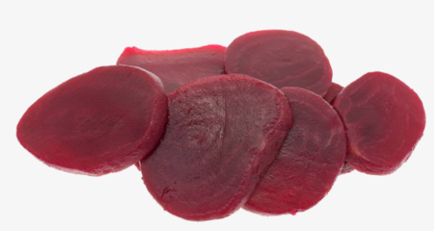
Choose as much salad as you like!
Lettuce
Cress
Sweetcorn
Cucumber
Click here to
choose your
potion of
fruit/veg.
Tomatoes
Beetroot

Slide 5


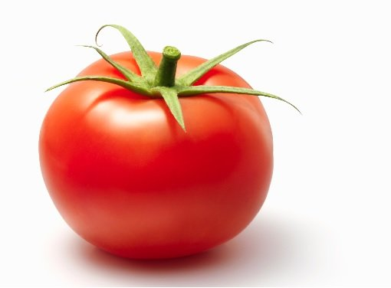

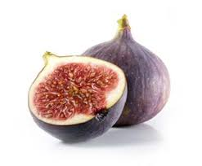

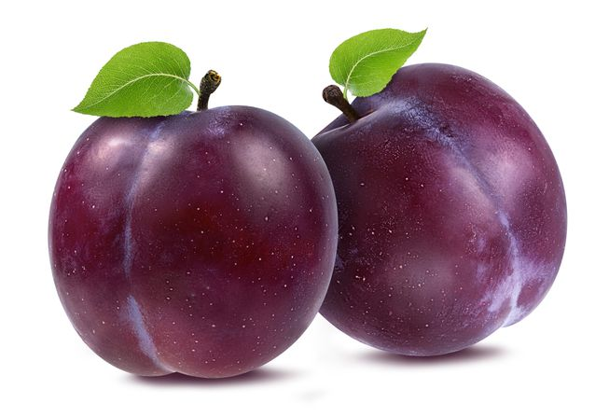

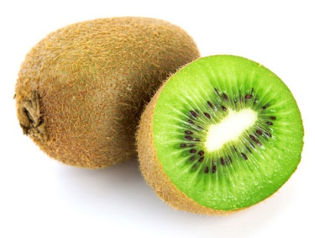
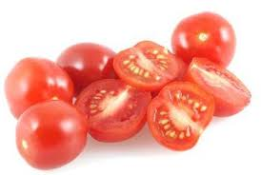
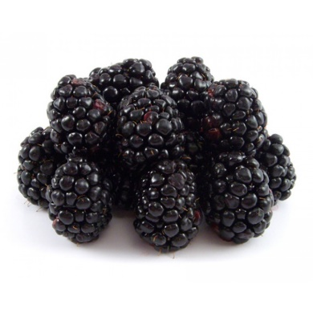
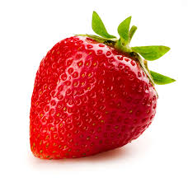
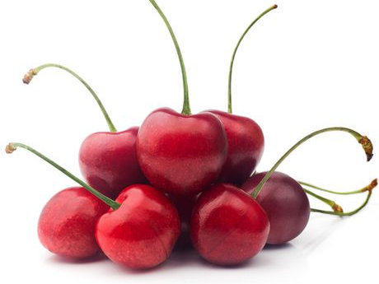

Choose one or two portions of fruit and/or vegetables
One medium banana
One medium tomato
One pear
Two figs
Two apricots
Seven cherry tomatoes
Two kiwis
One peach
Two plums
Two small oranges
Click here for
more fruit and
vegetable options
Seven strawberries
Nine blackberries
Eleven cherries
Fourteen
grapes

Slide 6
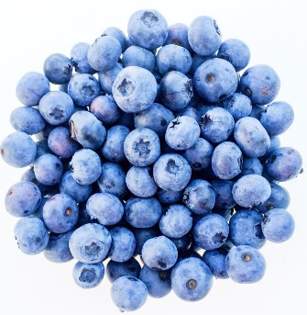


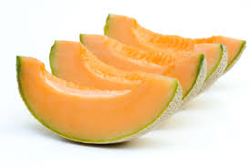


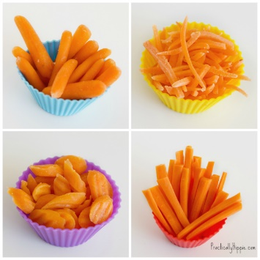
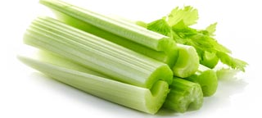
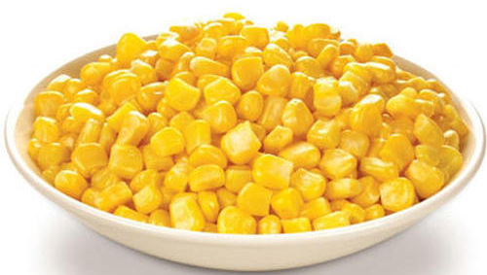
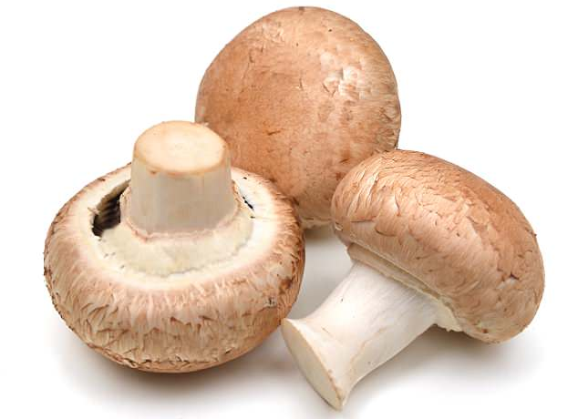

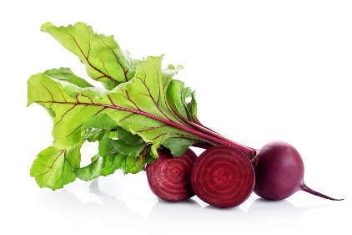
Choose one or two portions of fruit and/or vegetables
Twenty blueberries
Twenty raspberries
Half a grapefruit
Quarter of
a mango
Quarter of
a melon
Quarter of
a pineapple
Three heaped tables spoons of sweetcorn
One carrot
One stick of celery
Three mushrooms
Click here to
choose a little
something extra.
Seven slices of beetroot
Eleven mangetout

Slide 7

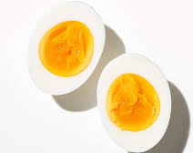
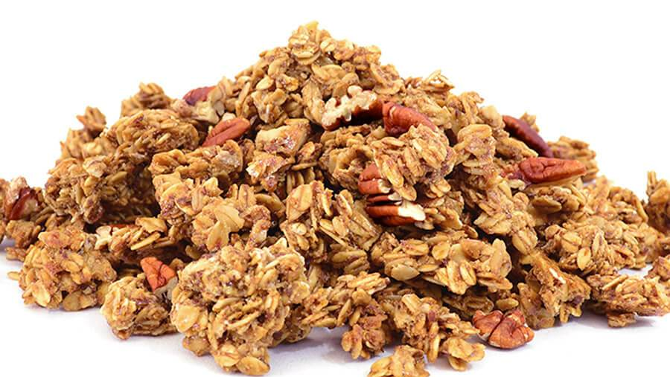
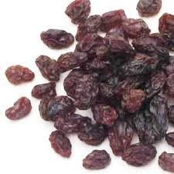

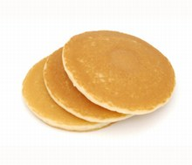


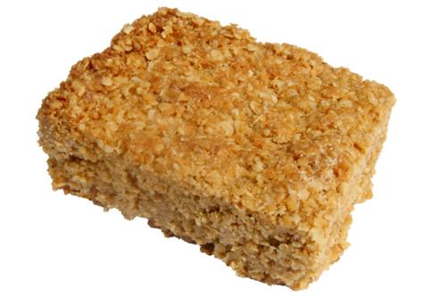
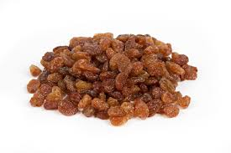
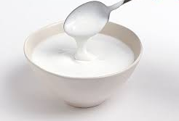
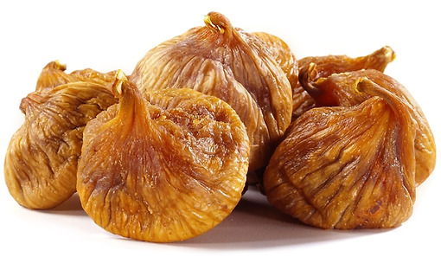
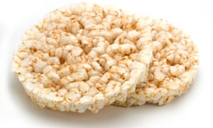

Finally, choose a little something extra
One cup of granola
One cup of popcorn
One crumpet
One tablespoon of raisons
One boiled egg
One tablespoon of sultanas
One hot cross bun
One scotch pancake
One small jelly
One small slice of flapjack
Click here for
more extras
One yogurt
Two dried figs
Two dried pineapple rings
Two rice cakes

Slide 8
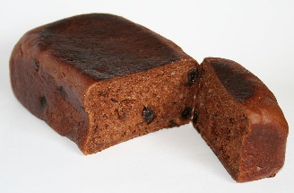

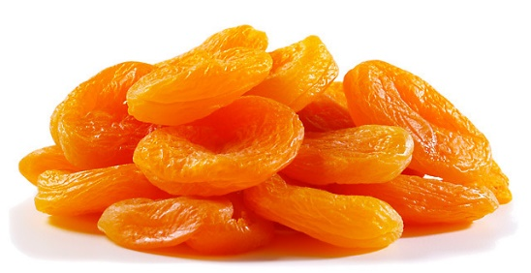
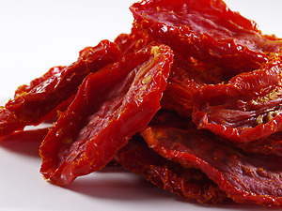


Finally, choose a
little something extra
You’ve now created a
healthy lunchbox!
Two slices of malt loaf
Three dates
Four dried apricots
Four sundried tomatoes
What will you choose next time…
Three slices of dried mango
Four slices of dried apple

